Slide 1
^{Programs and Pedagogy}
June 8, 2016 11:30 AM
Moderator Joel Katz, MD
Museum of Fine Arts, Boston & Harvard Medical School
Pennsylvania Academy of the Fine Arts
University of South Florida Contemporary Art Museum

Slide 2
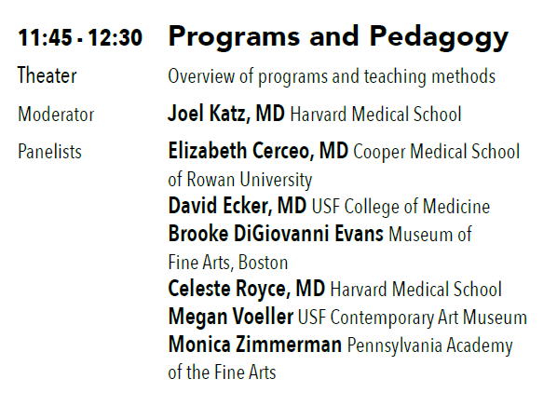

Slide 3
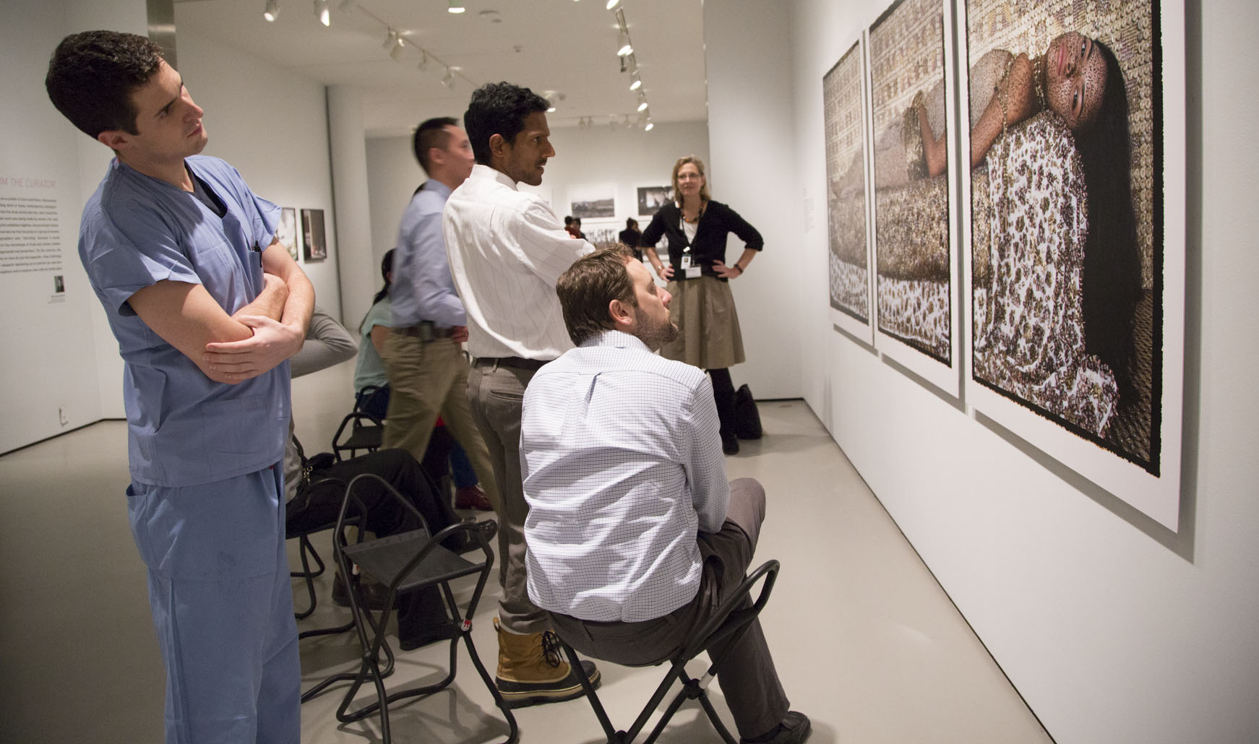
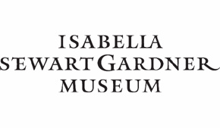


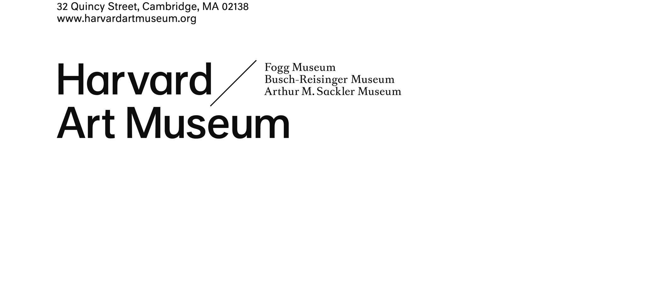

The Art of Examination: Art Museum and
Medical School Partnerships
Programs and Pedagogy
Joel T. Katz, MD, Moderator
Photographer: Tiziana Rozzo
Notes:
Is there a connection between art and medicine, and if so how can we exploit it to improve patient care?

Slide 4
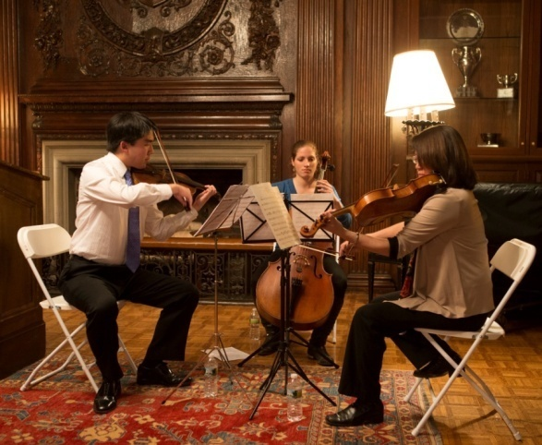

HMS Survey
(2012)
Active participation in the arts?
N = 13512
Faculty 9529
Residents/fellows 3124
Medical Students 709
Dental students 150
19% response rate
Can medical education at HMS be
enhanced by the arts?
Thanks to Susan Poires, MD

Slide 5
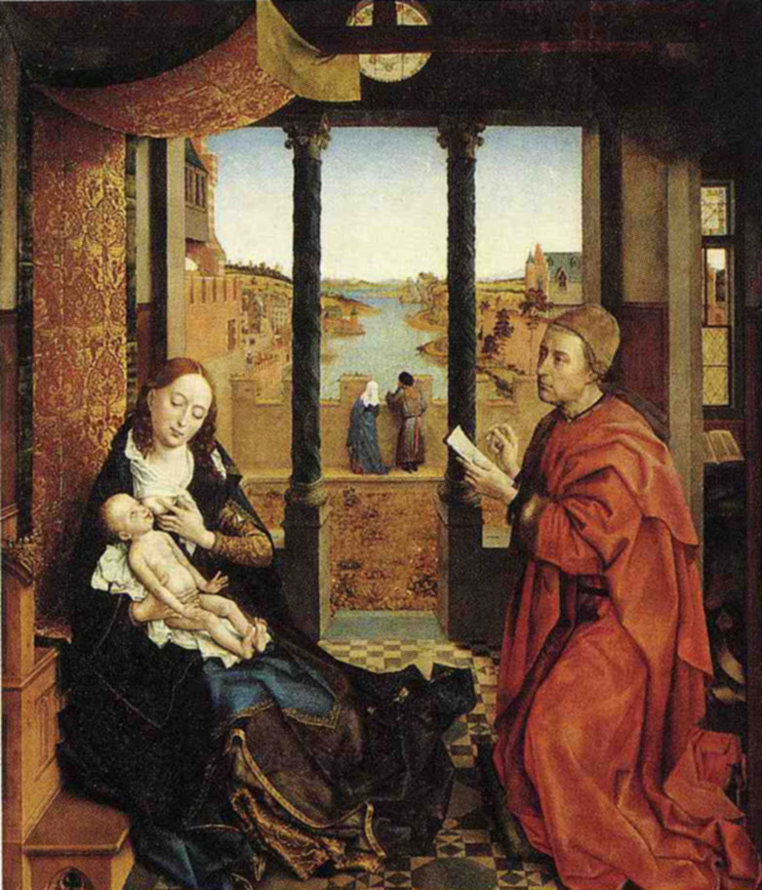
Van der Weyden
1435
Notes:
WHAT IS CONNECTIONS BETWEEN ART and MEDICINE?
Van der Weyden 1435 St Luke one of the 4 evangelists was a doctor author of 3rd gospel and acts of the apostles
A doctor non jew never saw jesus but wrote about him typical medical writing
Patron saint of drs and patron st of painters
painted the original virgin mary and invented religious frescos
///////////////
Before I try to answer this questions, I will share a bit of back of background on how I get here.

Slide 6
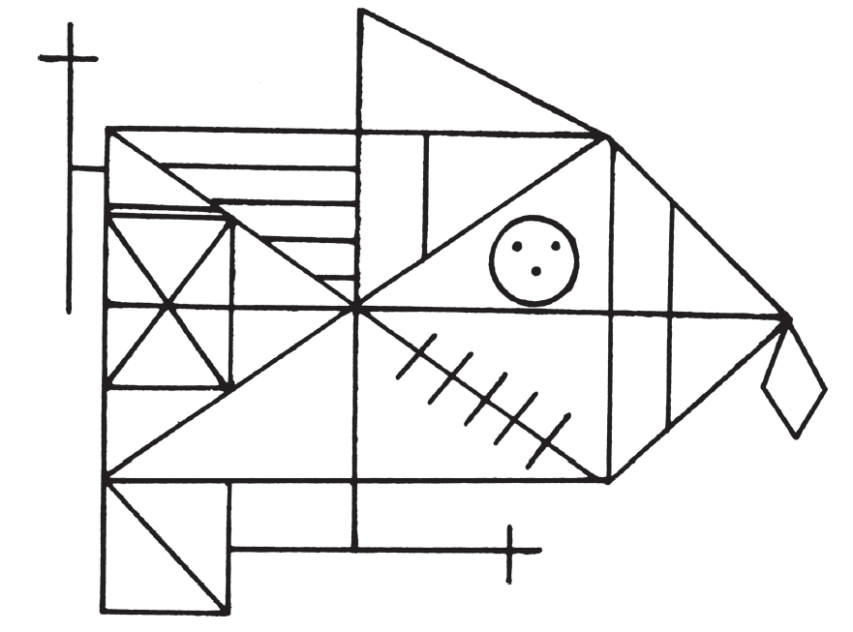
Rey–Osterrieth complex figure test
Notes:
As a clinician, and in the work I do in the museum, I see some of the value in the opportunity to:
Step outside one’s comfort zone
Tolerate (even embrace) ambiguity
Balance the small details and ‘big picture’
…illustrated in this neurology test
Rey–Osterrieth complex figure test
visuospatial abilities, memory, attention, planning, and working memory (executive functions).

Slide 7
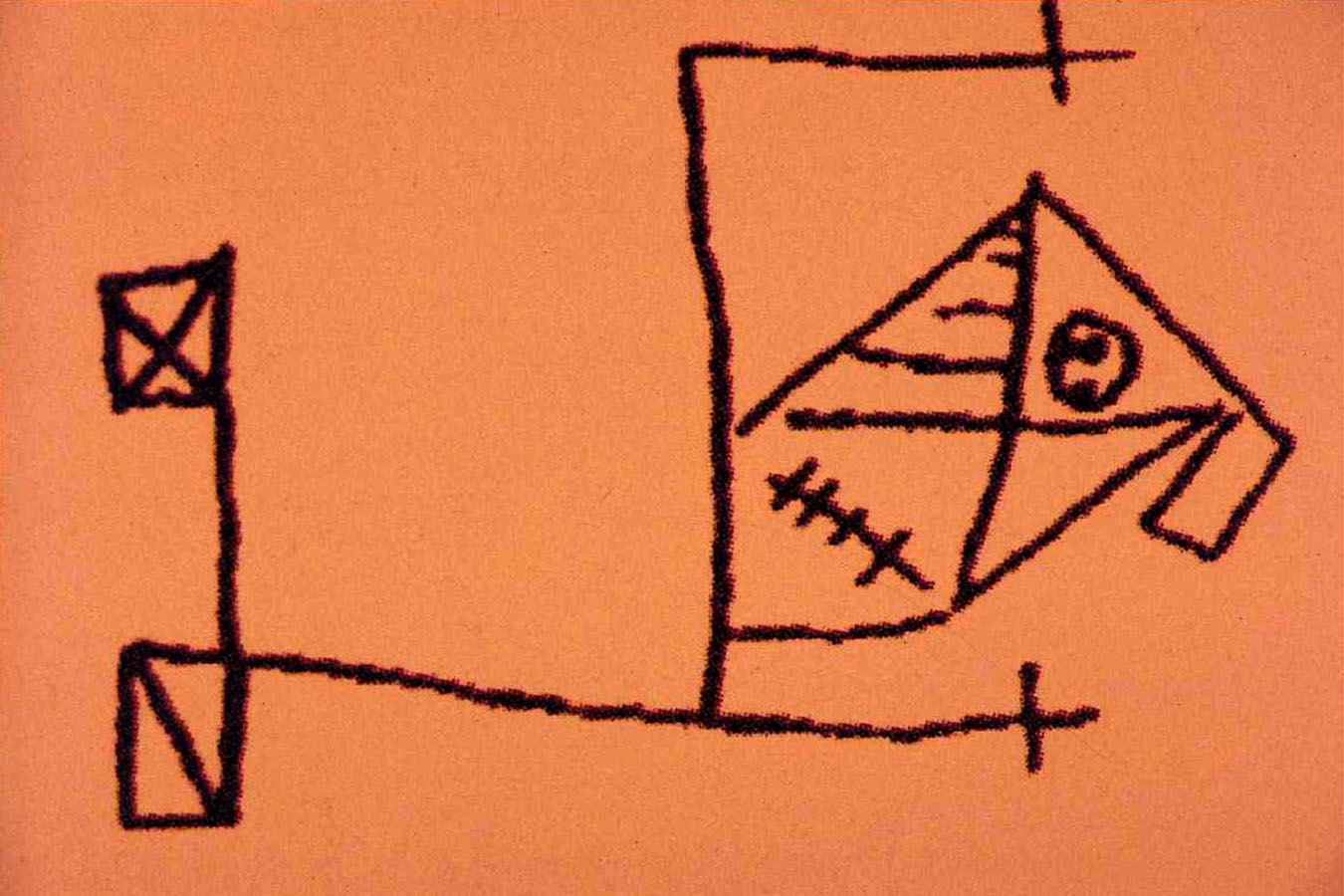
Notes:
RIGHT lesion
Details=left brain hemisphere

Slide 8
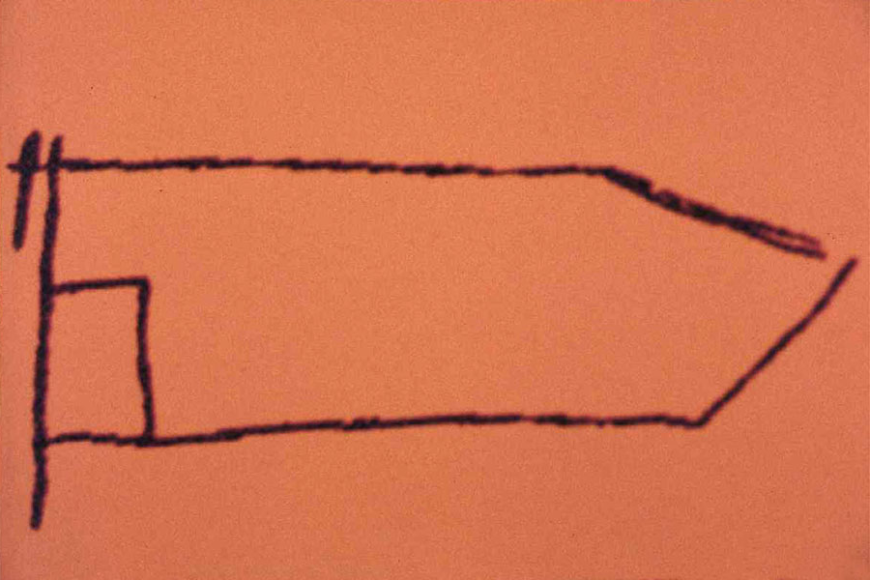
Notes:
LEFT lesion
Big picture=left brain hemisphere

Slide 9
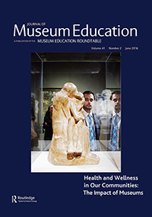
Notes:
1960-70’s small pilots
1979: Robert Coles – NEJM; professional lapses
1985: Barbara Hoshiko – “Nursing diagnosis at the art museum”
1994: Gerry Berg – Visual Arts and Medical Education
2001: Dolev, Friedlaender, and Braverman – “Use of fine arts to enhance visual diagnostic skills”
Medical School and Hospital based Programs
Outcomes research

Slide 10
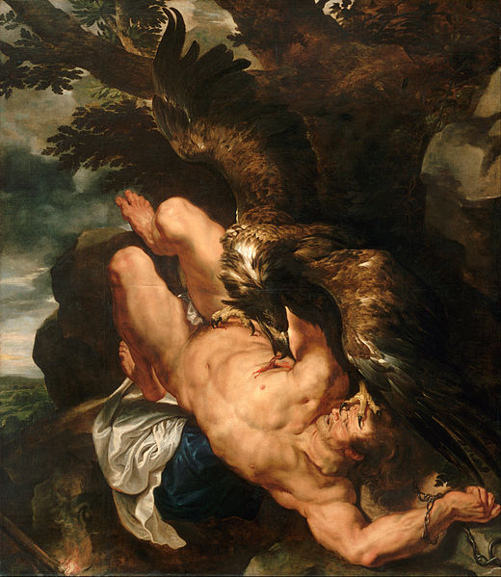
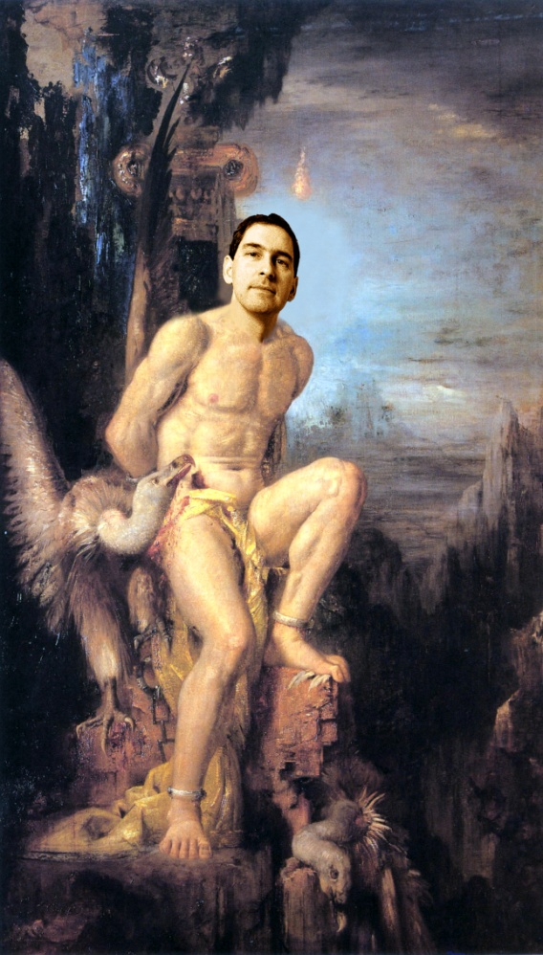
Apologies to
Gustave Moreau
P. Rubens 1618

Slide 11
Pub-Med Search (1965-2016)
Art + Medical Education + (Visual or Museum)
N = 158 68 (Excluded: Medical Illustration, Art Therapy, Art History)
Clinical
28
Physical Exam
21
Clin
Decision
Mkg
2
Radiology
2
Histology
1
Anatomy
2
Professionalism
25
Inter
-
professional
Teamwork
5
Cultural Awareness
2
Reflective Practice
2
Mindfulness
4
Patient
Centeredness
2
Empathy
4
Other
4
Art Making
8
Cartooning
2
Other
6
N=68
Communication
2
Methods
2
Review
3

Slide 12
Pub-Med Search (1965-2016)
Art + Medical Education + (Visual or Museum)
N = 158 68 (Excluded: Medical Illustration, Art Therapy, Art History)
Clinical
28
Physical Exam
21
Clin
Decision
Mkg
2
Radiology
2
Histology
1
Anatomy
2
Professionalism
25
Inter
-
professional
Teamwork
5
Cultural Awareness
2
Reflective Practice
2
Mindfulness
4
Patient
Centeredness
2
Empathy
4
Other
4
Art Making
8
Cartooning
2
Other
6
N=68
Communication
2
Methods
2
Review
3

Slide 13
Pub-Med Search (1965-2016)
Art + Medical Education + (Visual or Museum)
N = 158 68 (Excluded: Medical Illustration, Art Therapy, Art History)
Clinical Care
28
Physical Exam
21
Clin
Decision
Mkg
2
Radiology
2
Histology
1
Anatomy
2
Professionalism
25
Inter
-
professional
Teamwork
5
Cultural Awareness
2
Reflective Practice
2
Mindfulness
4
Patient
Centeredness
2
Empathy
4
Other
4
Art Making
8
Cartooning
2
Other
6
Communication
2
Methods
2
N=68
Review
3

Slide 14
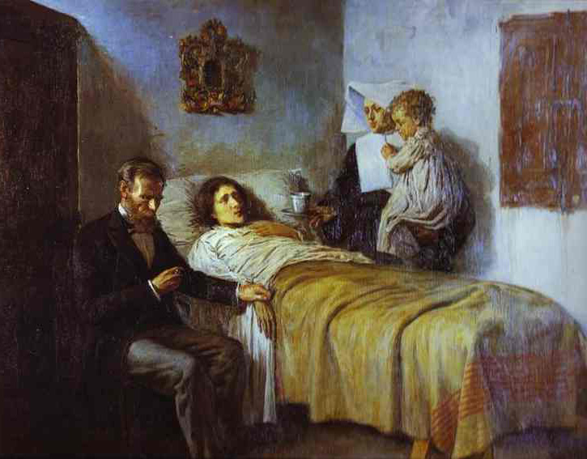
Pablo Picasso, Science and Charity (1897)
Notes:
Iconic
Emblematic: Detached, dispassionate dedication. Outward visions of compassion relegated to the nun.
Explore two topics: ART and PROFESSIONALISM, and their relationship.
Present 5 examples

Slide 15
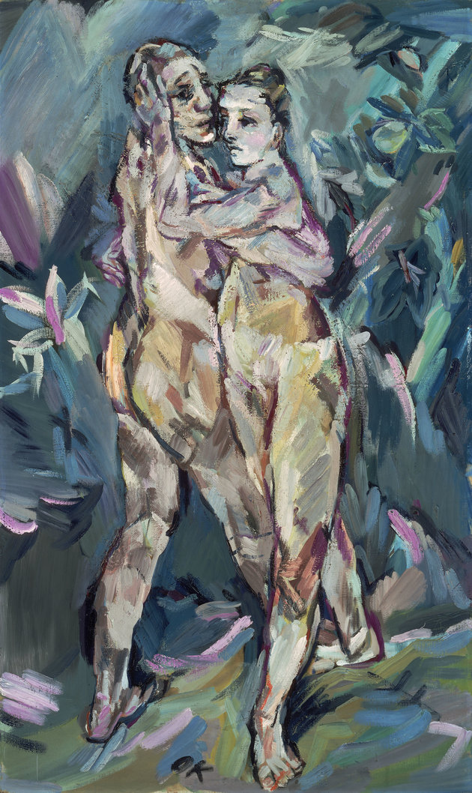
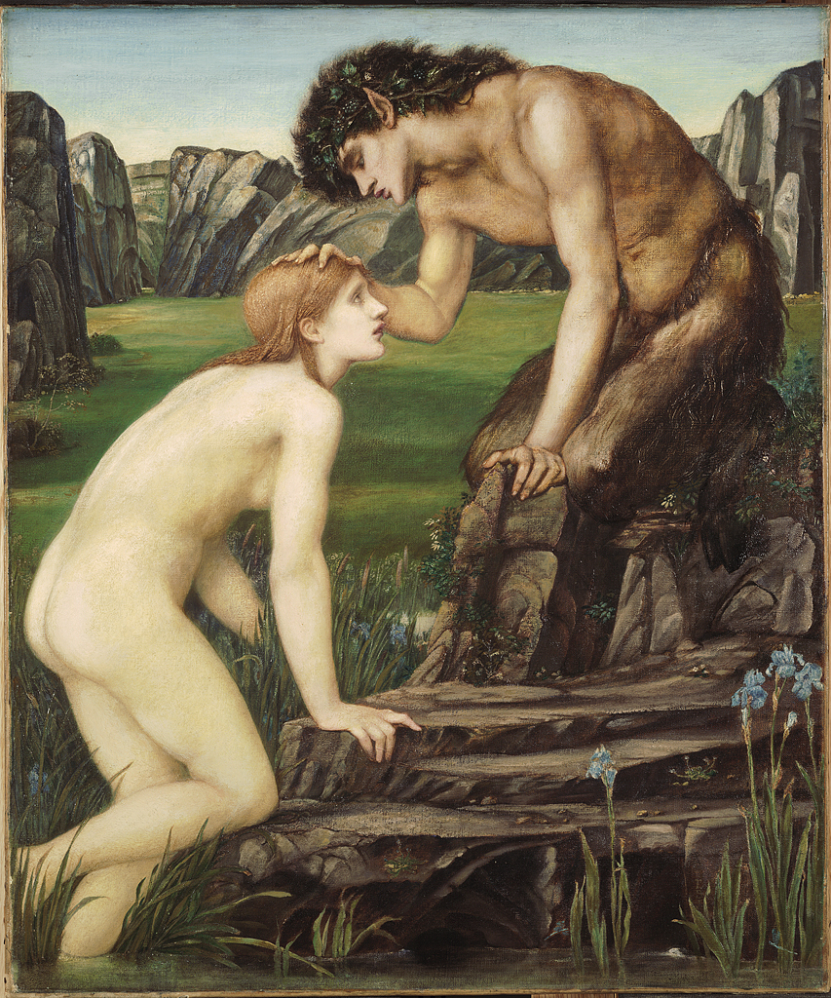
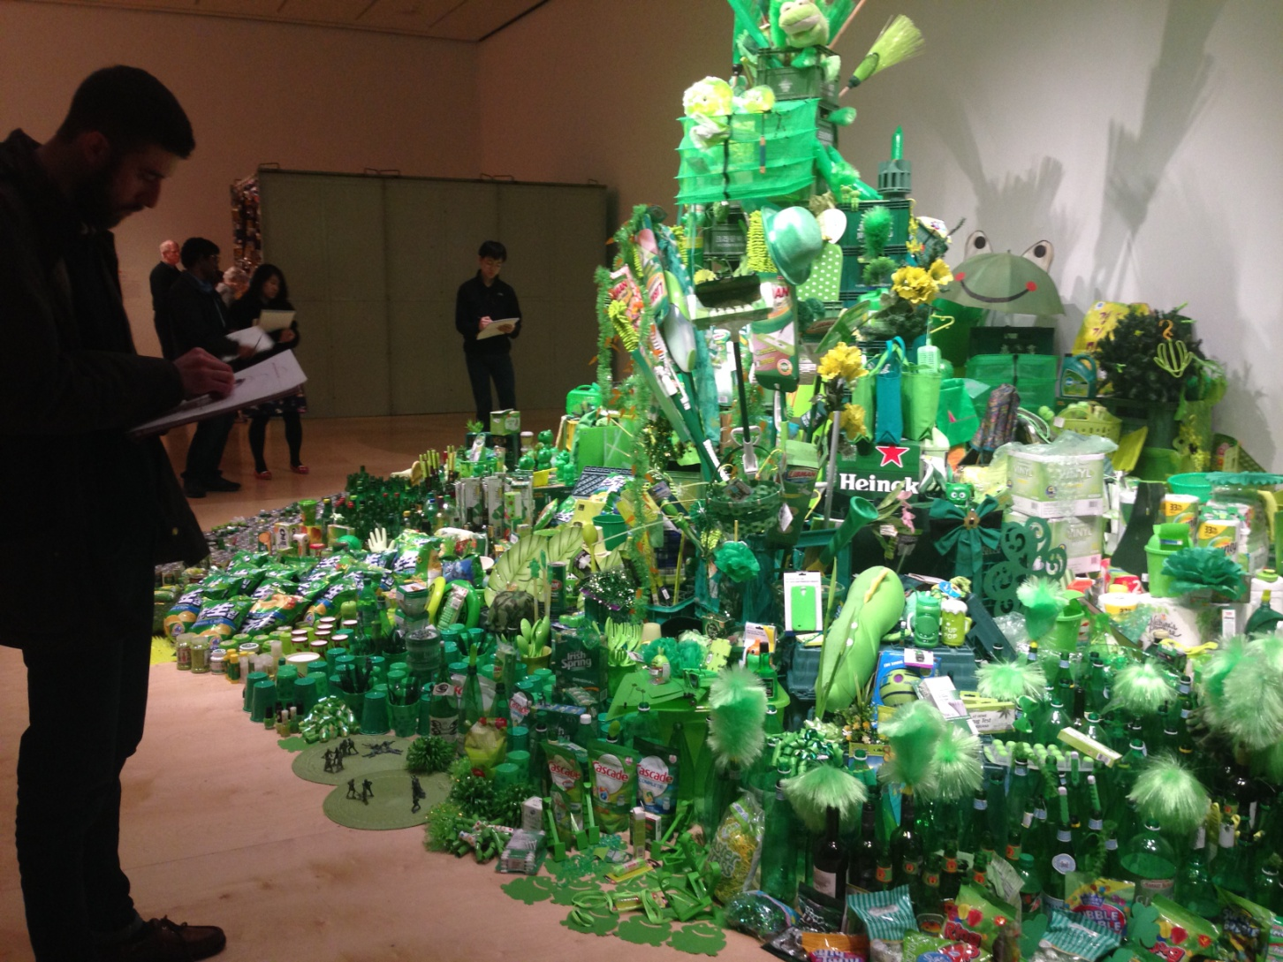
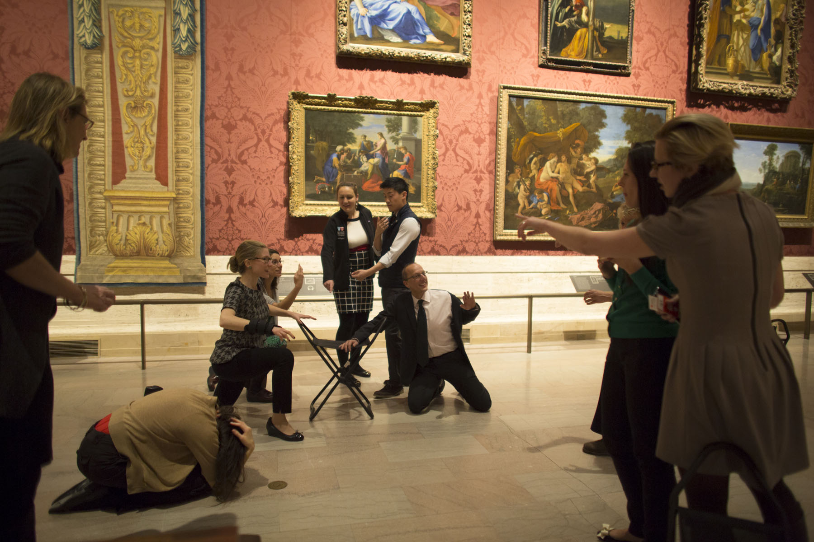
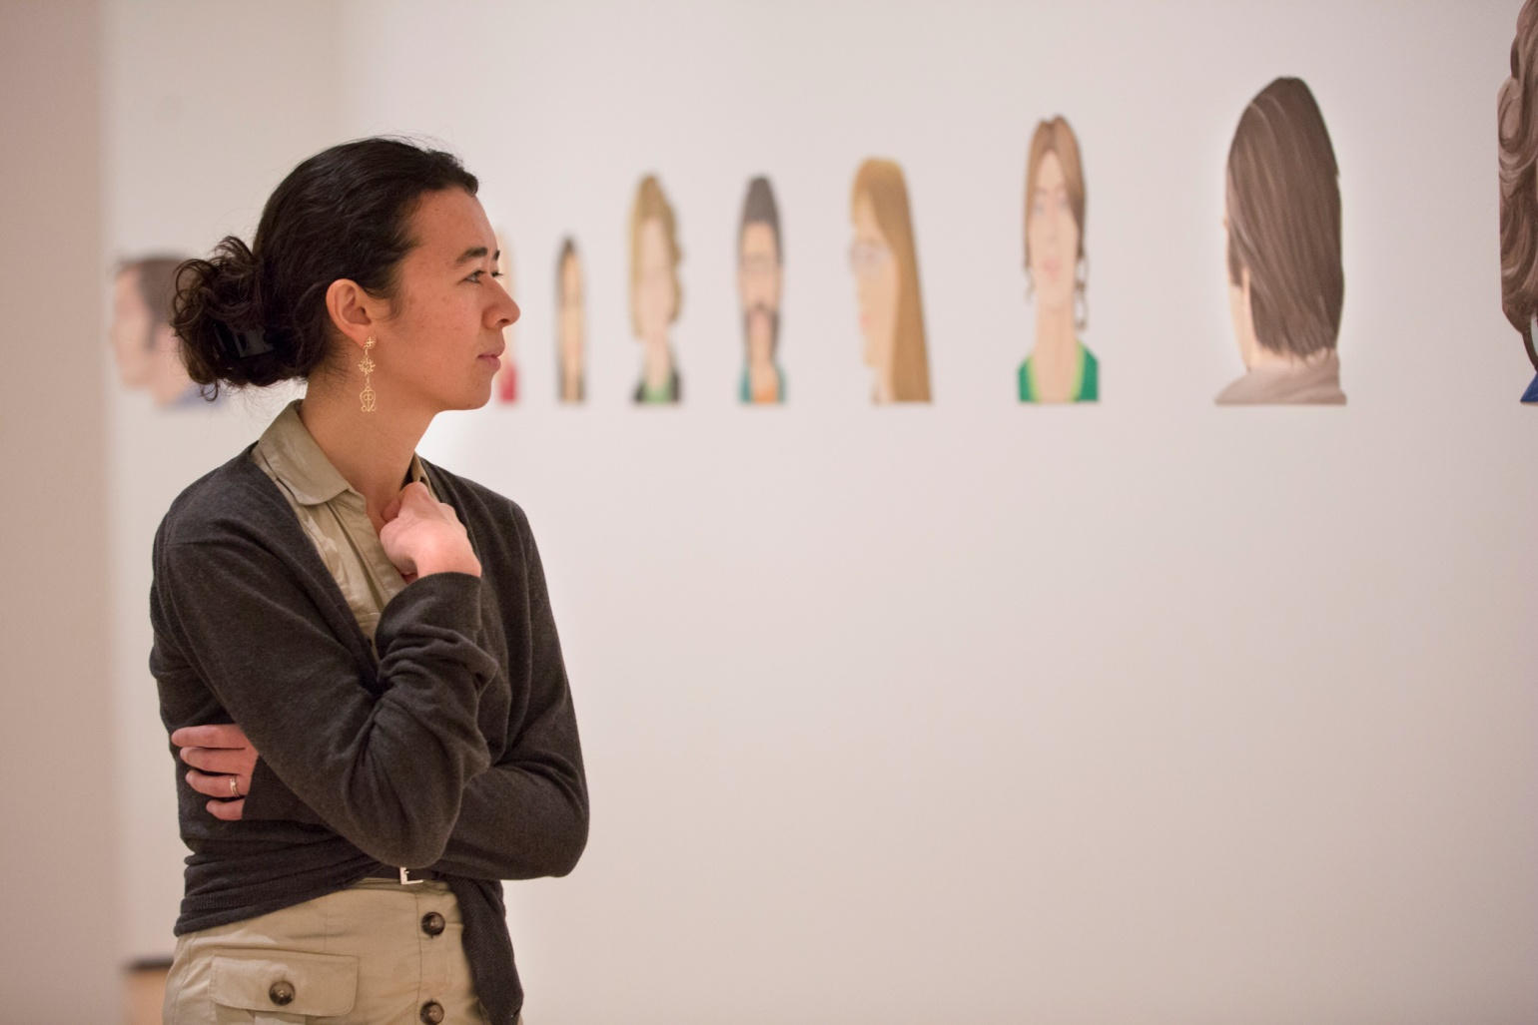
Programs and Pedagogy - Variability
(→ some features to look for)
Goals: How can art improve training (MD, RN, teams)?
  Clinical and diagnostic skills
  Professional skills
  Inter-professional skills
Curricular methods?
Timing in training?
Required vs. elective?
Defining and measuring relevant outcomes?
Opportunities to improved art museum-medical center collaboration.
Notes:
Not a “One size fits all” field.
Benefit from learning from colleagues’ creative problem solving.

Slide 16
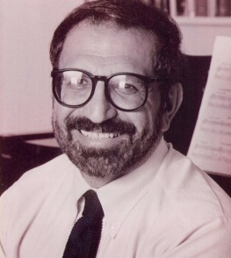
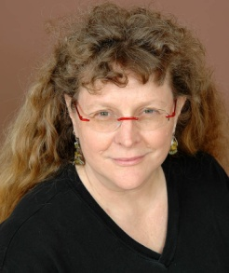
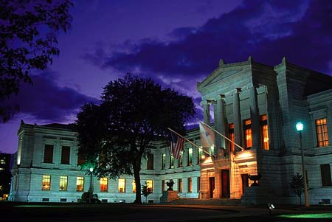
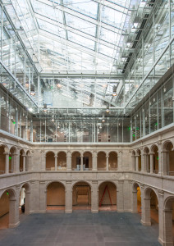
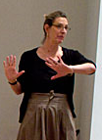
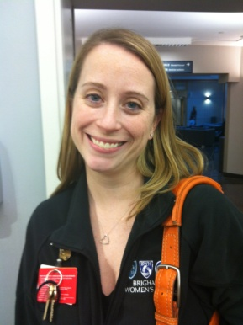
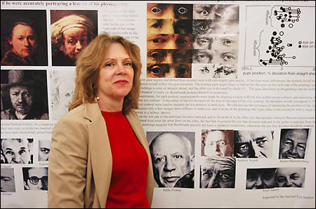
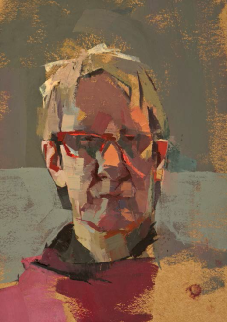
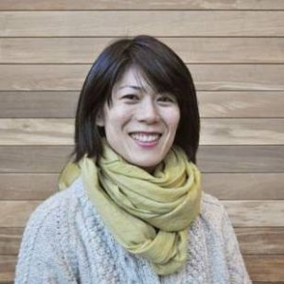
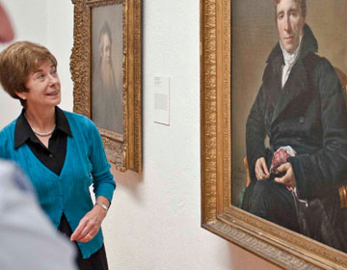
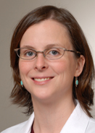
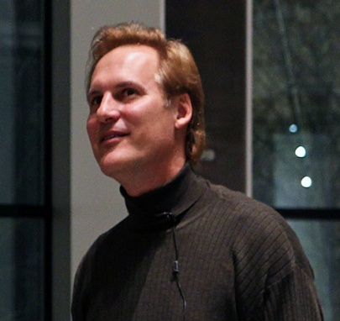
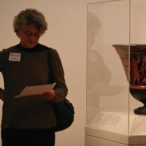
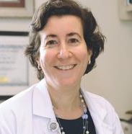
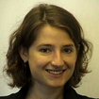
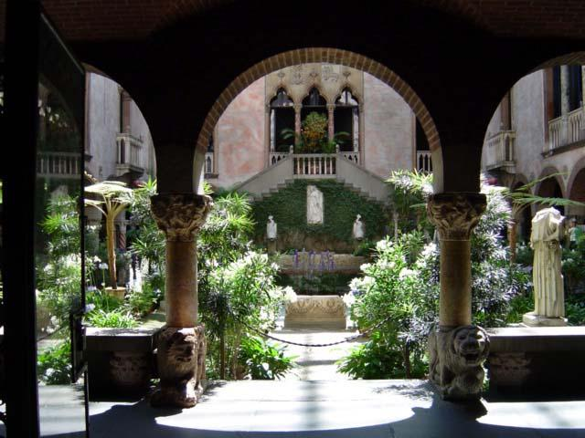
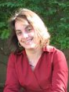
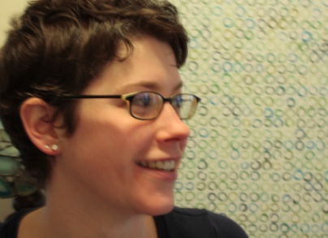
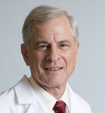
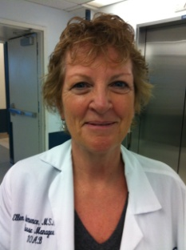
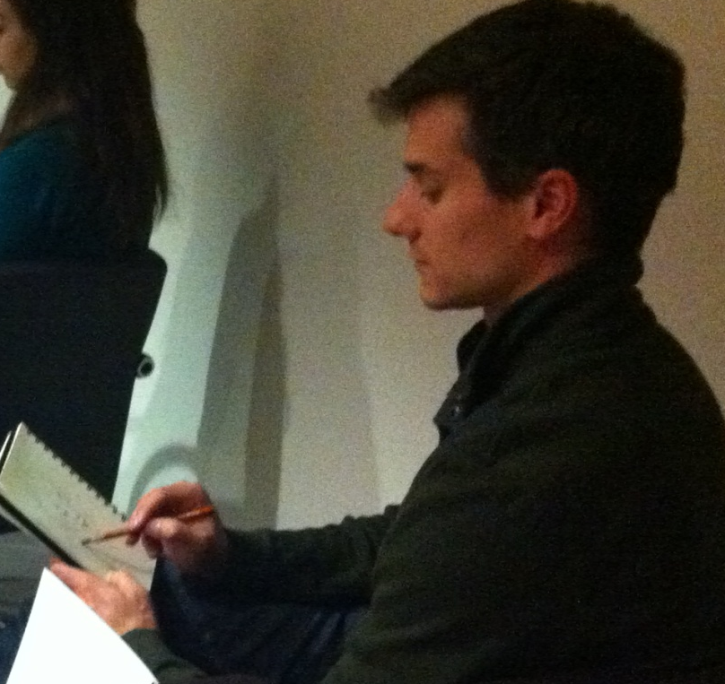
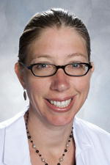
Collaborators
Notes:
Addresses universal concerns
Simultaneously emotional and intellectual
Transpires over time/history (longitudinal story)
Inherently ambiguous
Out of students’ “comfort zone”
Escape preconceptions
Distance inhibitions
Minimize performance anxiety
Viewer starts with what they know, and can always find more
Narrows gap between bioscience and human experience

Slide 17
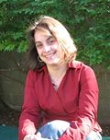
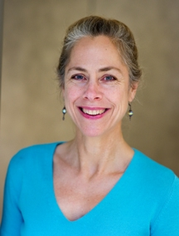
Programs and Pedagogy
Panelists
Brooke DiGiovanni Evans
Head of Gallery Learning
Museum of Fine Arts, Boston
Celeste Royce, MD
Instructor of OBGYN
Beth Israel Deaconess Medical Center, Harvard Medical School
Notes:
Brooke DiGiovanni Evans is the Head of Gallery Learning at the MFA, Boston. She oversees 80 gallery programs each month for all ages. Brooke has worked in art, science, natural history, and history museums. She currently serves as board President for the national Museum Education Roundtable. Brooke holds an Ed.M and Museum Studies certificate from Harvard.
Dr. Celeste Royce is an obstetrician/gynecologist generalist and co-director of the Residency Ambulatory Unit, whose main focus is patient safety, medical education, and addressing healthcare disparities. Her interests outside of work include music, running, kayaking, being outdoors, and spending time with her family.

Slide 18
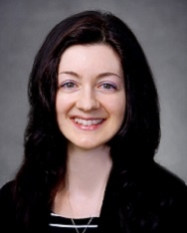
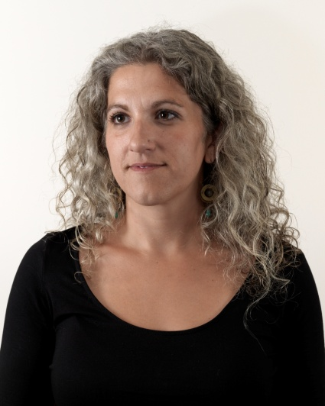
Programs and Pedagogy
Panelists
Elizabeth Cerceo, MD
Assistant Professor of Medicine
Cooper Medical School of Rowan University
Monica Zimmerman
Director of Museum Education
Pennsylvania Academy of the Fine Arts
Notes:
Dr. Elizabeth (Lisa) Cerceo is assistant professor of medicine at Cooper Medical School of Rowan University and a teaching fellow of their Academy of Master Educators. She also currently serves as the associate program director for the internal medicine residency where she develops novel curricula, mentors, and facilitates quality improvement and patient safety initiatives. She is course director for the Medical Humanities and leads the wellness initiatives at the medical school and hospital.
Monica Zimmerman is the Director of Museum Education at the Pennsylvania Academy of the Fine Arts in Philadelphia, PA and a lecturer in the Museum Studies Graduate Program at the University of the Arts. She received her M.A. from the University of the Arts in Museum Communication and her B.A. from Goshen College in English.
Title of the Course: Art of Observation Selective
Medical School Partner: Cooper Medical School at Rowan University
Length of the course/class – (include the number of sessions and length of time): 4 weeks, 2 hours each class
Summary of the course: Students receive a lecture overview of historic partnerships and collaborations between artists and medical professionals and how observational skills that are key to artistic production are also essential to medical training. Students then participate in a two hour close looking exercise in the galleries, a two hour exercise in which they learn to draw the human body from live models, and a two hour workshop on using art as a therapeutic methodology with patients.
Number of students served: 20 Students; 20 Residents; 20 Faculty
Evaluation: Pre and post-writing exercises; Budner’s; Santa Barbara Solids
Resources: link(s) to further reading and other resources

Slide 19
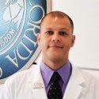
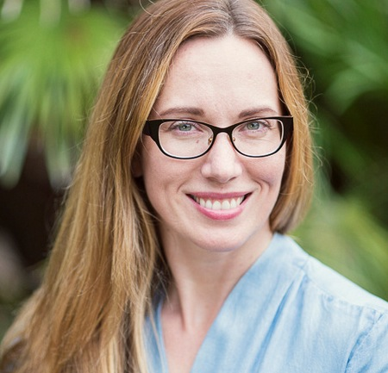
Programs and Pedagogy
Panelists
David Ecker, MD
Assistant Professor of Hospital Med
Morsani College of Medicine, University of South Florida
Megan Voeller
Associate Curator & Program Director, Art in Health
USF Contemporary Art Museum
Notes:
David Ecker is an assistant professor of hospital medicine at the University of South Florida, where he plays a large role in the development, innovation, and delivery of the undergraduate medical education curriculum. His interests in medical education include competency-based education, clinical skills development, interprofessional education, and simulation training. Nationally, Dr. Ecker is a member of the Society of General Internal Medicine’s Education Committee and is the Advocacy and Advancement Chair for the Directors of Clinical Skills Courses.
Megan Voeller is Associate Curator and Art In Health Program Director at the University of South Florida Contemporary Art Museum, where she organizes exhibitions and educational programs. She also maintains a practice as a visual art critic. Megan holds degrees in studio art, media studies and art history.

Slide 21

A Night at the Museum:
Using Visual Arts to Teach Wellness
Brooke DiGiovanni Evans M.Ed.
Katherine Johnson, MD
Laura Bookman, MD
Celeste Royce MD

Slide 22
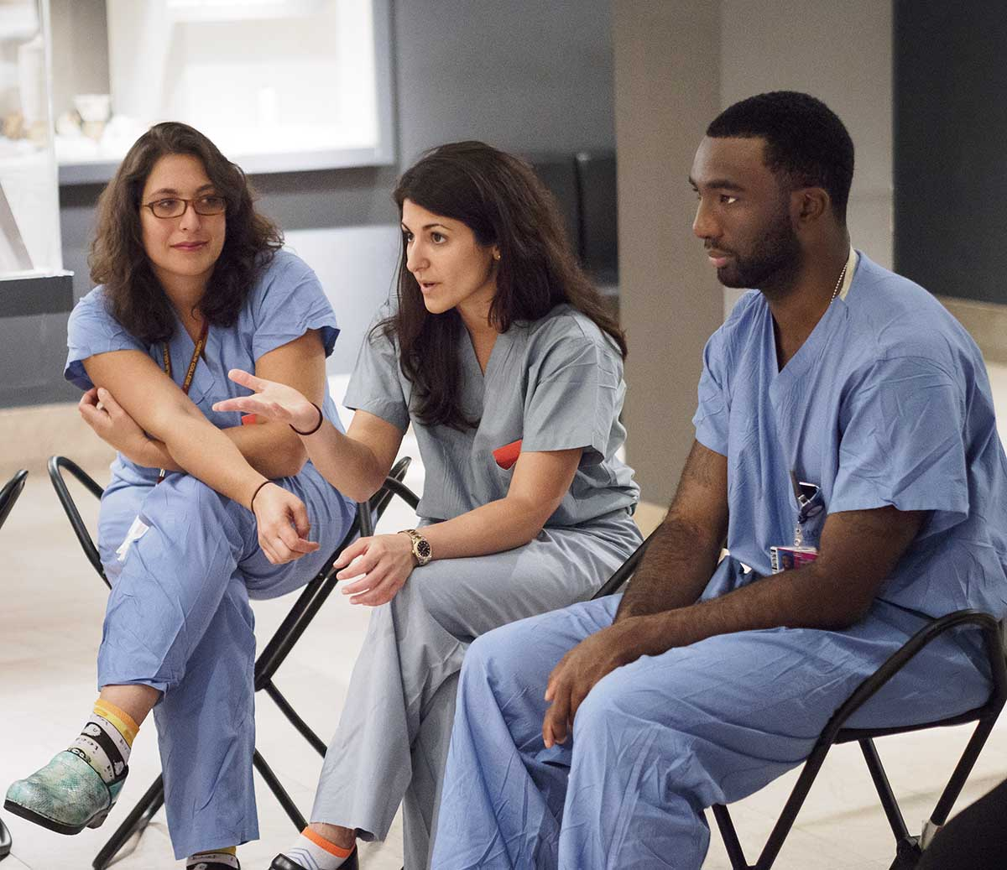
Course Outline
Started in 2014
4th year students and OBGYN Residents
Elective in protected time
Part of Wellness Initiative
8-10 participants per session
2 hour session in evening
Evaluated perceived stress levels before and after participation

Slide 23
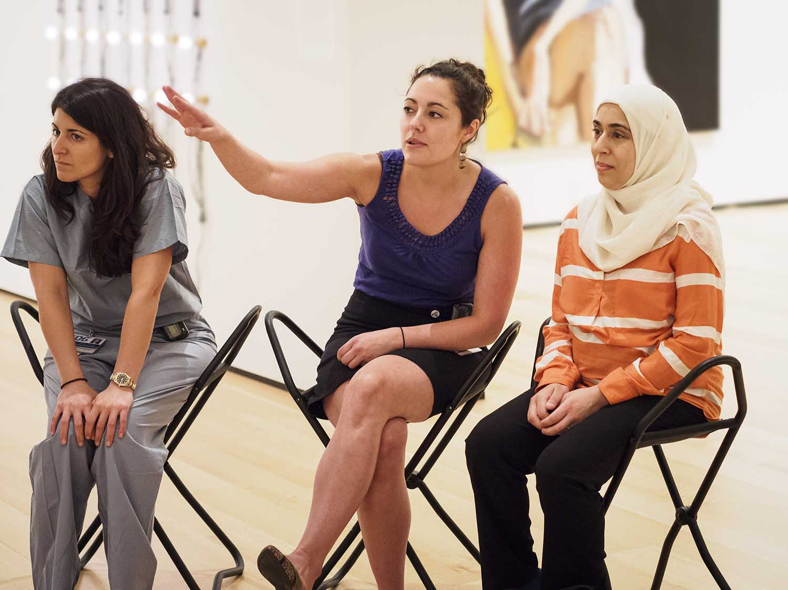
Goals and Competencies
Short, focused group activity
Promote wellness
Decrease stress
Increase reflective capacity
Emphasis on lifelong learning
Pilot program for teaching mindfulness
Prevent and address burnout
Address OBGYN Milestones in Professionalism, Interpersonal Skills and Shared Decision Making

Slide 24
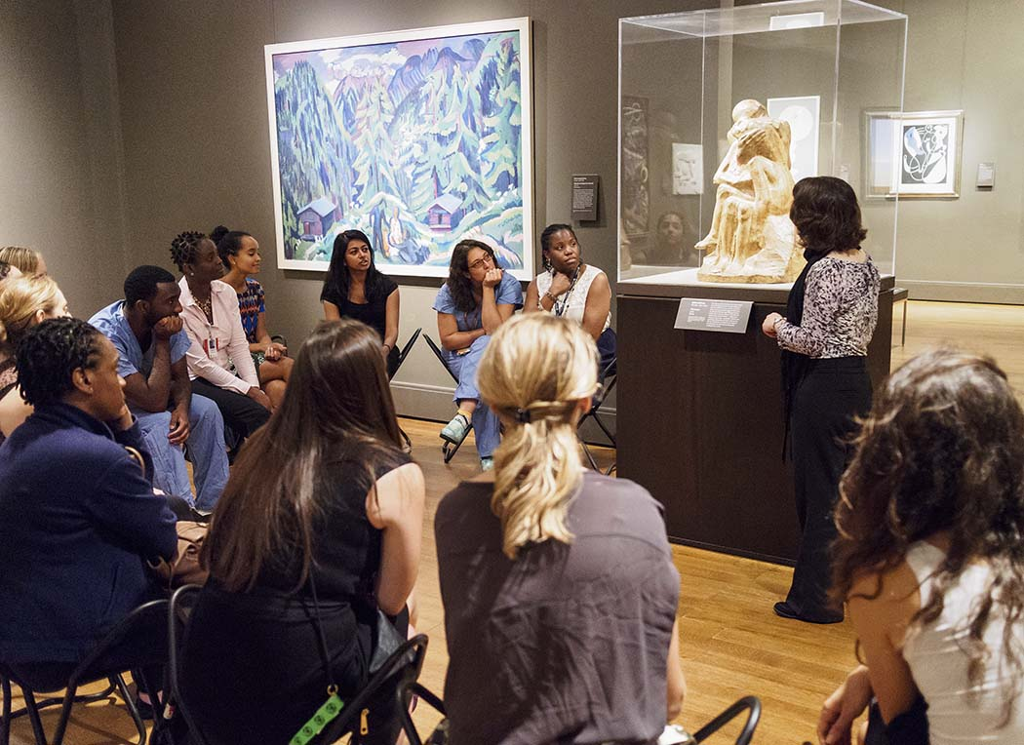
Workshop Activities
Introduction
Visual Thinking Strategies Discussion
Metaphors in Medicine, Art and Life
Drawing Activity
Relaxation Activity

Slide 25
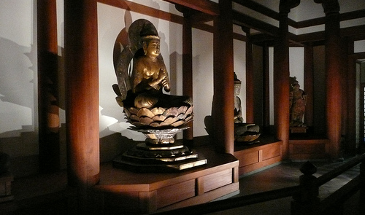
Highlight: Relaxation Exercise
Use of museum space as a protected or sacred space
Encourages participants to reflect on experiences and attend to self-renewal and self-care.

Slide 26
Harvard Medical School And Museum of Fine Arts Experience: Boot Camp

Slide 27
Harvard Medical School And Museum of Fine Arts Experience: Residency
N= 24
Median age 29
42% previous arts experience
11 on inpatient rotation
Pre and Post Activity Perceived Stress Scale
Trend toward decreased stress greatest in medical students (pre 18, post 15.5)
THEME | Number of interviews (%)
Program exposed different perspectives | 14 (64)
Program helped see colleagues in different way | 9 (41)
Program helped see situation differently | 10 (45)
Program was accessible | 14 (64)
Program different from what normally would do | 10 (45)
Positive response to program | 17 (77)
Program enhanced relationships with peers | 8 (36)
Program was fun | 7 (32)
Program was relaxing | 9 (41)
Connection between program and wellness made | 7 (32)
Opportunity for reflection | 12 (55)

Slide 28
Harvard Medical School and MFA, Boston:
Student Experience
Different perspectives:
“Sharing reflections and hearing other’s reflections on the art was a wonderful experience.”
Enhanced relationships with peers:
“Willingness of participants to share honestly; vulnerability is priceless.”
Relaxing:
“The last exercise- because of the importance of relaxing and work/life balance.”
Opportunity for reflection and expression of concerns:
“Hearing that my peers and professors have similar concerns/fears/anxieties; reminds me that I’m not the only one with worries.”
“The group dynamic and everyone participating helped me to see that everyone had similar concerns about starting residency and the fact that everyone was able to share that.”

Slide 29
Harvard Medical School and MFA, Boston:
Resident Experience
Different perspectives:
“[The experience is an] important metaphor for real life and working with people that see the same problem or patient in a totally different way.”
Accessible:
“It was a lot of fun for a non-creative person,” and “I was surprised how much we were able to talk about pieces of artwork.”
Fun:
“Loved reconnecting with my love of art. It’s been a while since I’ve been to a museum and had the time to slowly enjoy a few aspects of it.”
Relaxing:
“I was surprised how I felt relaxed almost immediately with entering the space of the museum.
Enhanced relationships with peers:
“It was nice to share the evening with fellow residents. I think one thing I have struggled with is feeling like I have no life outside of residency.”
A connection between the program and wellness was made:
“It gave me a few hours to escape life’s stressors.”
The program provided an opportunity for reflection:
“It reminded me to take a moment every day to reflect and relax.”

Slide 30

Future Directions: Next Steps
Workshop for Faculty
Expand to other BIDMC residencies
Article for medical journal
Include Death and Dying exercise
Continue studying impact through longitudinal studies

Slide 31
Notes:
Introduction (10 minutes) JK bio, BC Bio, thoughts on your roles as artist, educator, scientist

Slide 32


The Art of Observation Humanities Selective
Dr. Elizabeth Cerceo, MD, FACP, FHM
Assistant Professor, Division of Hospital Medicine
Associate Program Director of the Internal
Medicine Residency
Cooper Medical School at Rowan University
Monica Zimmerman, MA
Director of Museum Education
Pennsylvania Academy of the Fine Arts

Slide 33
Background
PAFA’s program initiated in 2013
CMSRU’s humanities track initiated in 2012
Designed program together in Fall 2014

Slide 34
Program Goals
Making medical students into wiser doctors by teaching them to…
Appreciate both historic and contemporary innovations in medical science that result from artistic interventions
Tolerate ambiguity
Improve physical observation acuity and diagnostic skills
Be emotionally intelligent
Identify personal bias and avoid premature conclusions
Support hypotheses with evidence
Develop collaboration skills
Adopt a visual vocabulary
Consider art as a therapeutic modality for self and patient
Avoid burnout by seeking learning experiences outside school
Apply textbook knowledge through kinetic learning

Slide 35
Audience
1st and 2nd year medical students
Residents
Attendings and faculty

Slide 36
Methods
4-week Humanities Selective class
Gallery Observation workshops for Residents
Gallery Observation workshops for Faculty
Anatomical Drawing workshops for Residents

Slide 37

Methods
Week 1: Historical Context

Slide 38

Methods
Week 2:
Gallery
Observation

Slide 39


Methods
Week 3:
Drawing nude models

Slide 40


Methods
Week 4:
Art as therapy

Slide 41

Methods
Residents and Faculty:
Gallery Observations

Slide 42

Residents Lunchtime Workshop: Anatomical Drawing

Slide 43
Measuring Outcomes
Observational inventories of paintings
Budner’s Tolerance for Ambiguity
Santa Barbara Solids Test
Jefferson Empathy Scale
Jeffreys Cultural Competency scale
Resident ACGME Milestones

Slide 44
Future Plans
Incorporating OSCE patients
Improvements in radiographic skills
Art as a tool for developing mindfulness
Three-Dimensional Wisdom Scale
Correlations with field of practice

Slide 45
Notes:
Introduction (10 minutes) JK bio, BC Bio, thoughts on your roles as artist, educator, scientist

Slide 46

The Art of Attending:
Training Interdisciplinary Healthcare Graduate Students at the
University of South Florida Contemporary Art Museum
In partnership with USF Health
Megan Voeller, MA
Dolores Coe, MFA
Merry Lynn Morris, MFA
Paul Reller, MFA
David Ecker, MD
Cheryl Zambroski, PhD, RN
Wendy Bedwell, PhD
Keaton Fletcher, BS

Slide 47

The Partners: University of South Florida
College of the Arts
  Contemporary Art Museum
  Fine Arts
  Music
  Theatre/Dance
USF Health
  Medicine
  Public Health
  Nursing
  Physical Therapy
  Pharmacy
Behavioral and Community Sciences
  Social Work
  Communication Science and Disorders
Arts and Sciences
  Industrial/Organizational Psychology
  Human Factors Psychology

Slide 48


Slide 49
  I find that attending, if done well, usually involves the following elements: slowing down and indulging in time in order to notice more fully the details, nuances and layers of an experience; recognizing that knowledge is not fixed; sustaining one’s focus in an activity/experience; adopting an explorative, open, inquisitive attitude; seeking connections and self-reflecting.
  – Merry Lynn Morris, University of South Florida Dance faculty member

Slide 50




Studio Art Workshop

Slide 51




Museum Workshop

Slide 52




Movement Workshop

Slide 53



Listening Workshop

Slide 54
Future Directions
Assessment
    Description
    Inferences
    Evidence
    Alternatives
  Why?
    Mindfulness
    Tolerance for Ambiguity
Workshop format
Curricular integration

Slide 55

Questions/Discussion?
Photographer: Tiziana Rozzo

